Slide 1

Computational Cognitive Science Project

Slide 2


Team Members
Rana Esmail Zekery
Menna Tullah Hany
Nadine Hazem

Slide 3
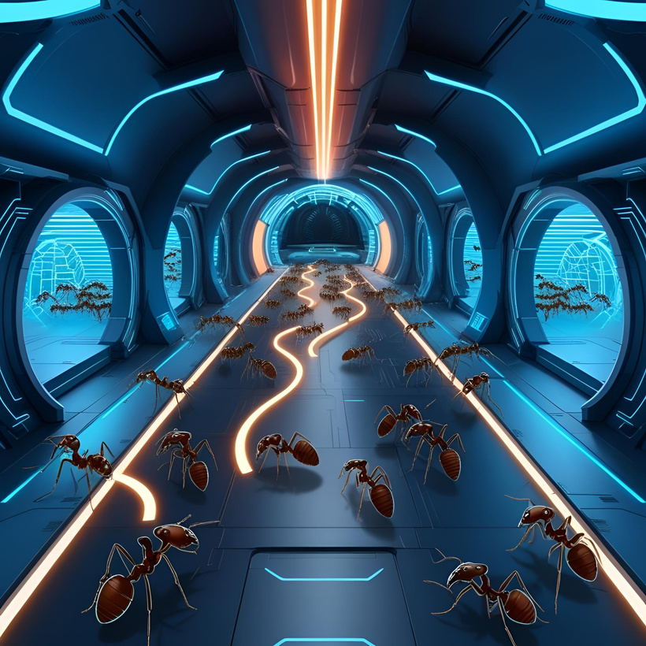
Part II: Ant Colony Optimization for TSP
01
INTRODUCTION TO THE TSP PROBLEM
02
UNDERSTANDING ANT COLONY OPTIMIZATION
03
IMPLEMENTATION APPROACH
04
GUI DEMONSTRATION
05
ALGORITHM ANALYSIS RESULTS
06
CONCLUSIONS

Slide 4



THE TRAVELING SALESMAN PROBLEM
DEFINITION
REAL-WORLD APPLICATIONS
MATHEMATICAL FORMULATION
COMPLEXITY
Finding the shortest possible route that visits each city exactly once and returns to the origin
Logistics, planning, manufacturing, DNA sequencing
Presentations are
communication tools
that can be used as
lectures.
NP-hard problem - no efficient exact algorithm for large instances

Slide 5
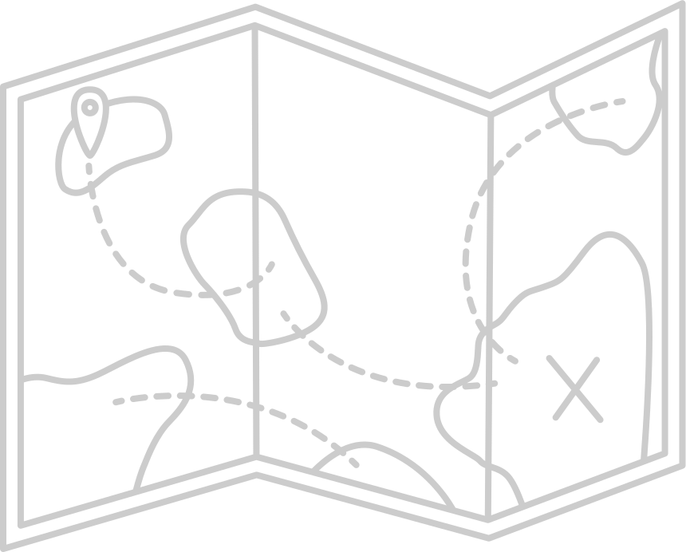
Traditional Solutions to TSP
Exact algorithms
Heuristic approaches
Metaheuristics
Branch and bound, dynamic programming Guaranteed optimal solution but exponential time complexity
Nearest neighbor, greedy algorithms Fast but often suboptimal
Genetic algorithms, simulated annealing Balance between solution quality and computational cost

Slide 6
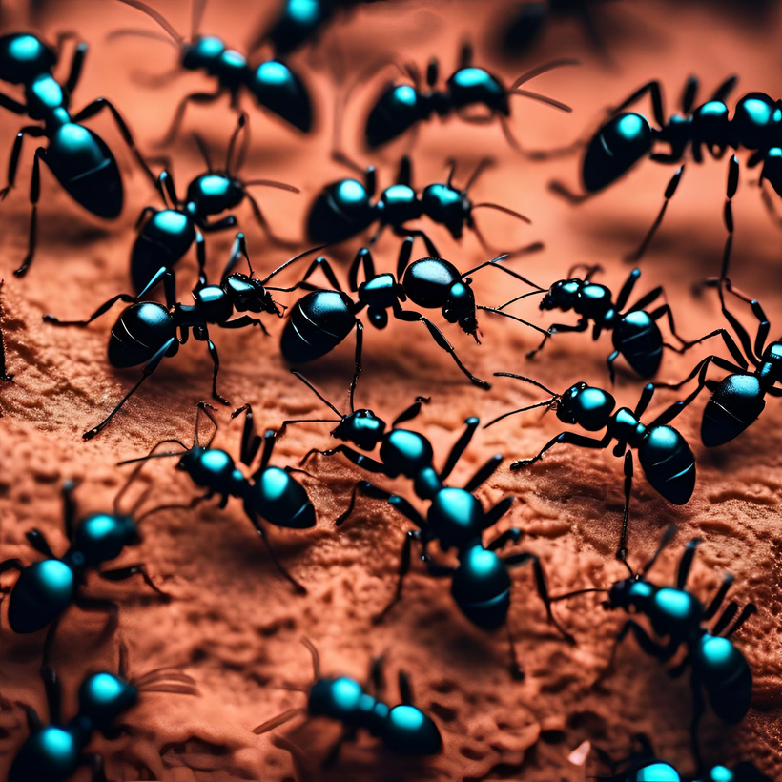
Ant Colony Optimization - Inspiration
ACO ADVANTAGE
Nature-inspired, good balance of quality & speed
INSPIRATION
Ants lay pheromones to find shortest paths

Slide 7
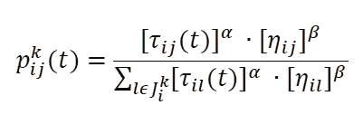
ACO Algorithm Overview
How It Works
Virtual ants build solutions based on pheromone trails & distance
Probability Formula:
Core Parameters
α: Pheromone influence
β: Heuristic (greediness)
ρ: Evaporation rate
Q: Pheromone quantity

Slide 8
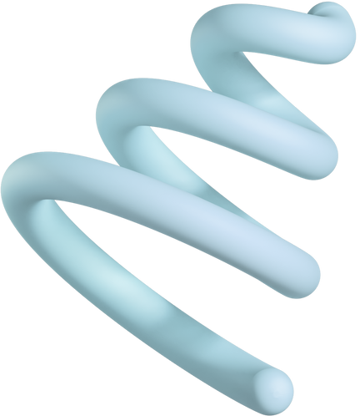
Key Classes
GRAPH
ANT
COLONY
Generates distances, computes path cost
Builds path using probabilities
Manages ants, updates pheromones, tracks best path

Slide 9
Partial vs Full Path Construction
STRATEGY COMPARISON:
PaRTIAL PATH
Higher exploration, potentially better quality
FULL PATH
Simpler implementation, faster execution
2.PERFORMANCE TRADEOFFS:
SOLUTION QUALITY VS COMPUTATIONAL EFFICIENCY
EARLY CONVERGENCE VS THOROUGH SEARCH

Slide 10

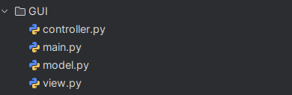
SYSTEM ARCHITECTURE
01
PATTERN:
Model-View-Controller (MVC)
02
COMPONENTS
Model: ACO algorithm (Graph, Ant, Colony)
View: PyQt6 GUI
Controller: Connects logic and interface

Slide 11
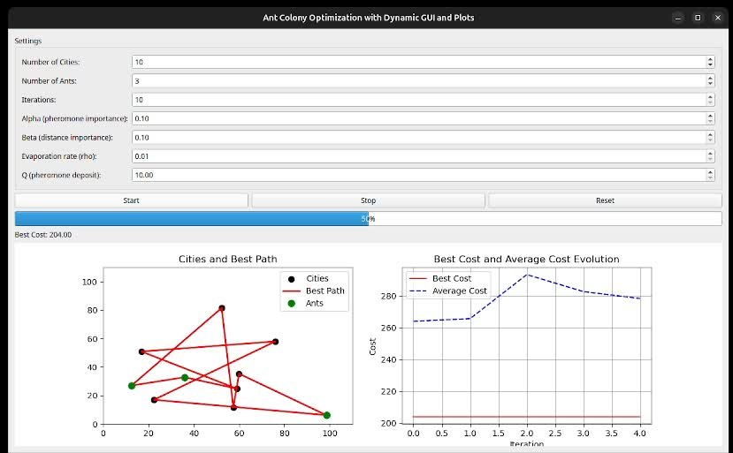

GUI Features
Interactive Controls: Set α, β, ρ, ants, cities
Visualizations:
City map & current best path
Real-time path updates
Cost progression graph

Slide 12
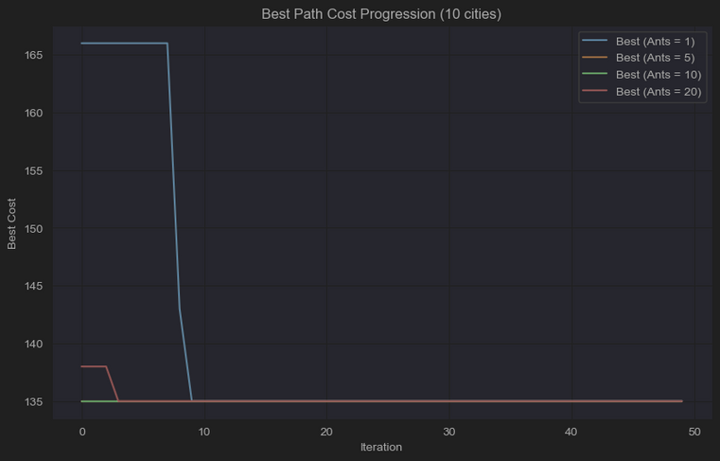
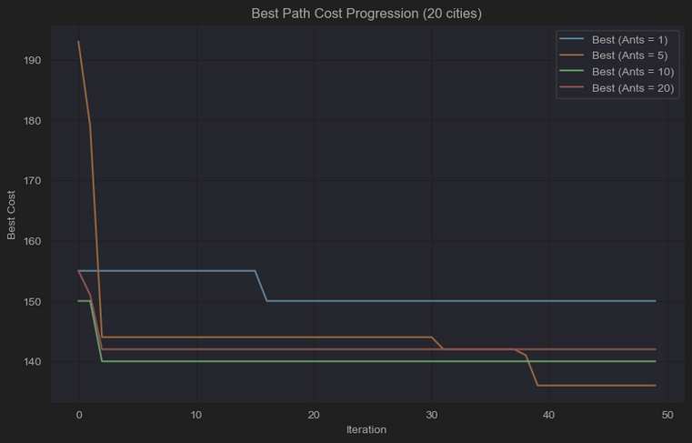
Results
FINDINGS
COLONY SIZE:
Larger colonies = better RESULTS, BUT DIMINISHING RETURNS
PROBLEM SIZE:
MORE CITIES = SLOWER CONVERGENCE, HIGHER VARIANCE

Slide 13

CONCLUSIONS
VISUAL INTERFACE AIDS COMPREHENSION
ACO PERFORMS WELL ON MEDIUM-SIZED TSP INSTANCES
EFFECTIVE BALANCE OF PARAMETERS CRITICAL FOR PERFORMANCE

Slide 14



Q&A
Repository link: Optimization-Algorithms-Tetris-TSP

